Slide 1
Basic Concepts for Neural Networks
Week 6
Ph.D. Junetae, Kim
Assistant professor

Slide 2
Basic Concepts for Neural Networks
Introduction to Perceptron Working Mechanism

Slide 3
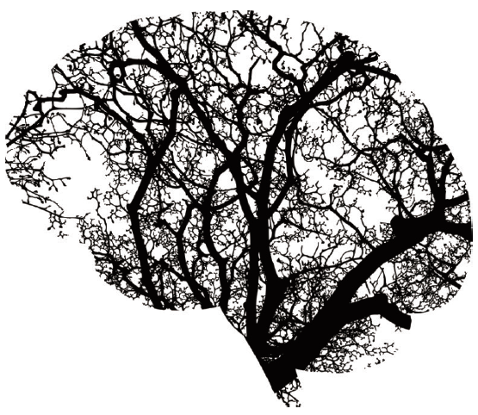
Basic Concepts for Neural Networks
What is perceptron?
Algorithm that returns true if the input data exceeds a certain level by the activation function and false otherwise
What this circuit does is similar to the role of neurons in the human brain.
Input, x
f(x)
Output, y

Slide 4
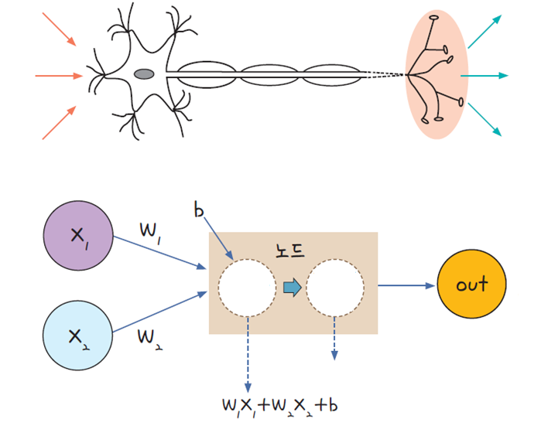
Basic Concepts for Neural Networks
Basic mechanism
The mechanism of perceptron is to connect multiple layers of perceptron together and combine them in complex ways to make decisions when given inputs.
Stimulation
Decision
Nodes
Input
weighted sum
activation
Output
ex) sigmoid

Slide 5




Basic Concepts for Neural Networks
Basic mechanism
Nodes
Input
weighted sum
activation
Output
ex) sigmoid
$$y_{a}=w_{1}x_{1}$$
$$y^{∗}=y_{a}+y_{b}+b$$
$$outcome= \frac{1}{1+\exp^{−y^{∗}}}$$
$$y_{b}=w_{2}x_{2}$$
Sigmoid transformation
w: weight ≈ slope
b: intercept ≈ bias

Slide 6

Basic Concepts for Neural Networks
Understanding perceptron mechanism in terms of data structure
Patient ID | Age | Height
1 | 56 | 181
2 | 33 | 168
W₁ | W₂
0.5 | -0.2
Bias
9.5
Weights
Bias
Given dataset
$$y^{∗}=0.5∗56−0.2∗181+9.5=1.3$$
$$outcome= \frac{1}{1+\exp^{−1.3}}=0.786$$

Slide 7




Basic Concepts for Neural Networks
Understanding perceptron mechanism in terms of matrix operations
Patient ID | Age | Height
1 | 56 | 181
2 | 33 | 168
W₁ | W₂
0.5 | -0.2
Bias
9.5
Weights
Bias
Given dataset
$$\left(\begin{matrix}56 & 181 \\ 33 & 168\end{matrix}\right)$$
$$\left(\begin{matrix}0.5 & −0.2\end{matrix}\right)$$
$$\left(9.5\right)$$
Weight Matrix(WM)
Data Matrix(DM)
$$y^{∗}=DM ×{WM}^{T}+bias$$

Slide 8

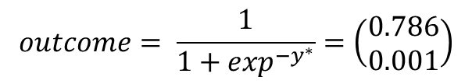


Basic Concepts for Neural Networks
Understanding perceptron mechanism in terms of matrix operations
$$y^{∗}=DM ×{WM}^{T}+bias$$
$$DM ×{WM}^{T}=\left(\begin{matrix}56 & 181 \\ 33 & 168\end{matrix}\right)×\left(\begin{matrix}0.5 \\ −0.2\end{matrix}\right)=\left(\begin{matrix}−8.2 \\ −17.1\end{matrix}\right)$$
$$y^{∗}=\left(\begin{matrix}−8.2 \\ −17.1\end{matrix}\right)+9.5=\left(\begin{matrix}1.3 \\ −7.6\end{matrix}\right)$$
$$outcome= \frac{1}{1+\exp^{−y^{∗}}}=\left(\begin{matrix}0.786 \\ 0.001\end{matrix}\right)$$

Slide 9
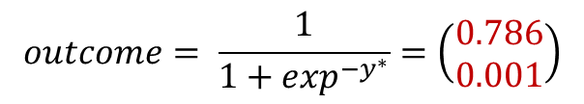
Basic Concepts for Neural Networks
Understanding perceptron mechanism in terms of matrix operations
$$y^{∗}=DM ×{WM}^{T}+bias$$
$$DM ×{WM}^{T}=\left(\begin{matrix}56 & 181 \\ 33 & 168\end{matrix}\right)×\left(\begin{matrix}0.5 \\ −0.2\end{matrix}\right)=\left(\begin{matrix}−8.2 \\ −17.1\end{matrix}\right)$$
$$y^{∗}=\left(\begin{matrix}−8.2 \\ −17.1\end{matrix}\right)+9.5=\left(\begin{matrix}1.3 \\ −7.6\end{matrix}\right)$$
Patient ID | Age | Height | Prob.
1 | 56 | 181 | 0.786
2 | 33 | 168 | 0.001
$$outcome= \frac{1}{1+\exp^{−y^{∗}}}=\left(\begin{matrix}0.786 \\ 0.001\end{matrix}\right)$$

Slide 10
Basic Concepts for Neural Networks
Understanding perceptron mechanism by python manual code
https://colab.research.google.com/github/JunetaeKim/DeepLearningClass/blob/main/Week6/Week6_MatMul.ipynb

Slide 11
Basic Concepts for Neural Networks
Limitation of Perceptron

Slide 12
Basic Concepts for Neural Networks
Limitation of a single perceptron
If classification problems get a little complicated, it cannot be solved with a single perceptron

Slide 13
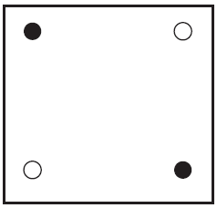
Basic Concepts for Neural Networks
Limitation of a single perceptron
Let's establish the basic concept of a neural network by examining the limitations of the perceptron and the process of solving it with an example
Two black dots and two white dots inside a square

Slide 14
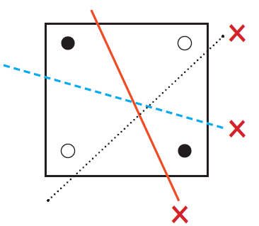
Basic Concepts for Perceptron (Neural Network)
Limitation of a single perceptron
Can there be a straight line that classifies one side with only black points and the other with only white points?
Two black dots and two white dots inside a square

Slide 15
Basic Concepts for Neural Networks
Limitation of a single perceptron
Can there be a straight line that classifies one side with only black points and the other with only white points?
Impossible with one line
Two black dots and two white dots inside a square

Slide 16
Basic Concepts for Neural Networks
XOR (exclusive OR) problems
The XOR is a concept that appears in logic circuits
There are 3 gates (AND, OR, XOR), and a gate is a rule that, given an input, returns an output
AND
OR
XOR
x1 | x2 | return
0 | 0 | 0
0 | 1 | 0
1 | 0 | 0
1 | 1 | 1
x1 | x2 | return
0 | 0 | 0
0 | 1 | 1
1 | 0 | 1
1 | 1 | 1
x1 | x2 | return
0 | 0 | 0
0 | 1 | 1
1 | 0 | 1
1 | 1 | 0
1 is returned, when both x1 and x2 are 1
1 is returned,
if either one of them is 1
1 is returned,
if only one of the two inputs is exclusively true

Slide 17
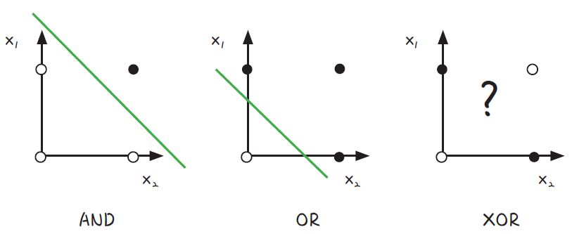
Basic Concepts for Neural Networks
XOR (exclusive OR) problems
Whether there is a straight line that classifies black dots on one side and white dots on the other side
White points if 0 is returned
Black points if 1 is returned

Slide 18
Basic Concepts for Neural Networks
XOR (exclusive OR) problems
In AND and OR gates, one line can classify both groups, but in XOR gates it cannot.

Slide 19
Basic Concepts for Neural Networks
Introduction to Multilayer Perceptron

Slide 20
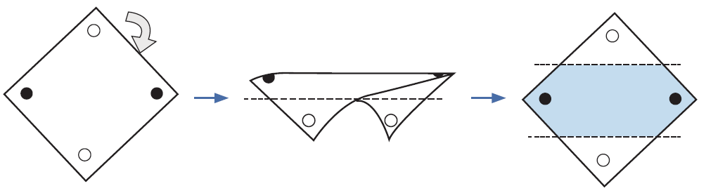
Basic Concepts for Neural Networks
Background and motivation for multilayer perceptron development
It was proven that one line cannot solve the XOR problem by Marvin Minsky(1969)
New approaches were attempted to solve this problem
The solution to the XOR problem is to bend the plane!

Slide 21
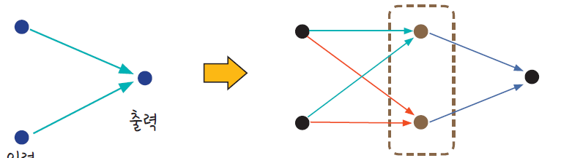
Basic Concepts for Neural Networks
Introduction to multilayer perceptron
Attempts were made to solve the XOR problem by developing perceptron models that connects multiple layers.
This type of models is called ‘multilayer-perceptron’, multiple layers are called ‘hidden layers’
Perceptron
Multilayer Perceptron
Output
Output
Input
Input
Hidden layer

Slide 22
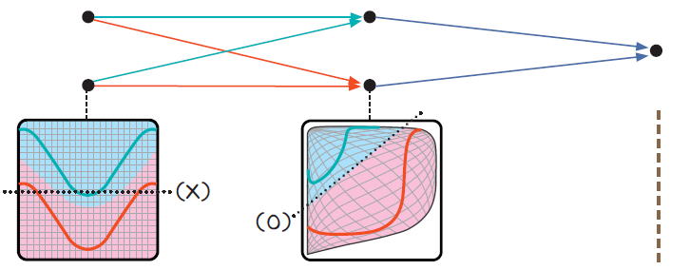
Basic Concepts for Neural Networks
Introduction to multilayer perceptron
When values are given, a straight line cannot separate the blue and red areas
The hidden layer creates the effect of creating a new coordinate system by bending the coordinate plane
Input
Hidden layer
Output

Slide 23
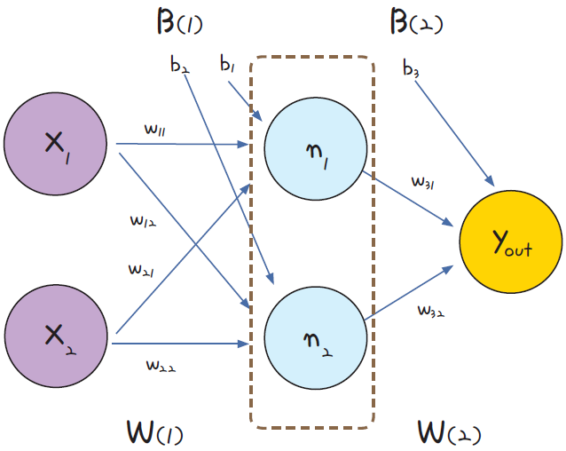
Basic Concepts for Neural Networks
Basic structure of multilayer perceptron
The input data is multiplied by weights(W₍₁₎) and added with bias(B₍₁₎), then sent to the hidden layer
The values ​​of the hidden layer are once again multiplied with the weights(W₍₂₎) and added with bias(B₍₂₎), then the final output value is calculated through the sigmoid transformation.
n₁ and n₂ represent nodes
hidden layer

Slide 24
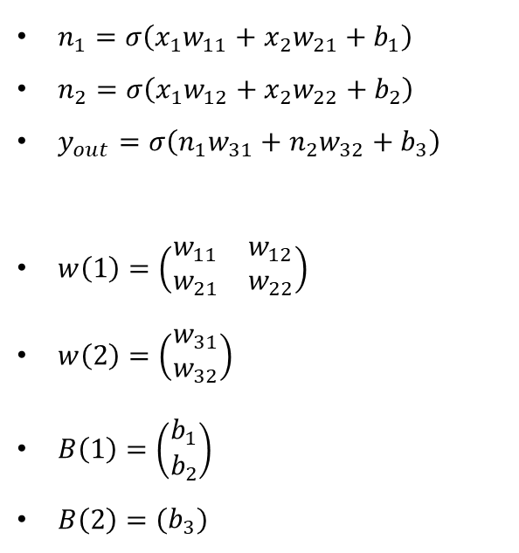
Basic Concepts for Neural Networks
Basic structure of multilayer perceptron
Mathematical notation
$n_{1}=σ\left(x_{1}w_{11}+x_{2}w_{21}+b_{1}\right)$
$n_{2}=σ\left(x_{1}w_{12}+x_{2}w_{22}+b_{2}\right)$
$y_{out}=σ\left(n_{1}w_{31}+n_{2}w_{32}+b_{3}\right)$
$w\left(1\right)=\left(\begin{matrix}w_{11} & w_{12} \\ w_{21} & w_{22}\end{matrix}\right)$
$w\left(2\right)=\left(\begin{matrix}w_{31} \\ w_{32}\end{matrix}\right)$
$B\left(1\right)=\left(\begin{matrix}b_{1} \\ b_{2}\end{matrix}\right)$
$B\left(2\right)=\left(\begin{matrix}b_{3}\end{matrix}\right)$
hidden layer

Slide 25
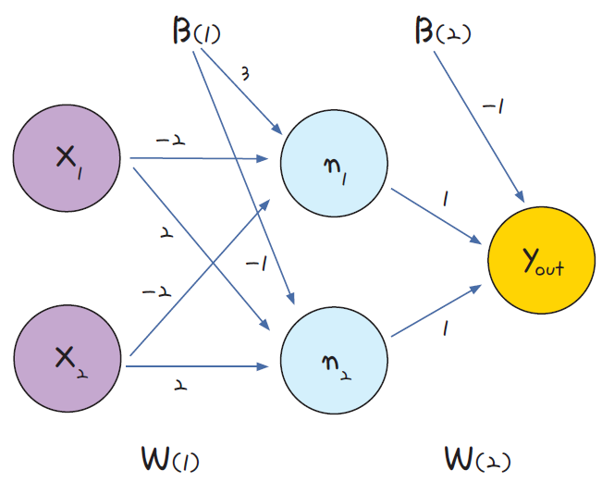
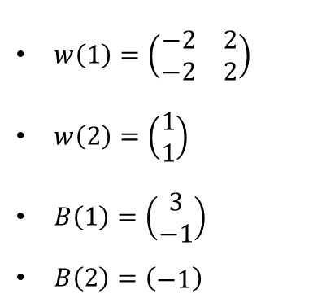
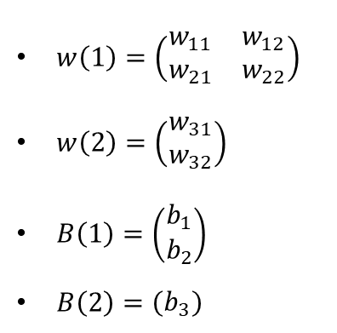
Basic Concepts for Neural Networks
Solving the XOR problem using multilayer perceptron
$w\left(1\right)=\left(\begin{matrix}w_{11} & w_{12} \\ w_{21} & w_{22}\end{matrix}\right)$
$w\left(2\right)=\left(\begin{matrix}w_{31} \\ w_{32}\end{matrix}\right)$
$B\left(1\right)=\left(\begin{matrix}b_{1} \\ b_{2}\end{matrix}\right)$
$B\left(2\right)=\left(\begin{matrix}b_{3}\end{matrix}\right)$
$w\left(1\right)=\left(\begin{matrix}−2 & 2 \\ −2 & 2\end{matrix}\right)$
$w\left(2\right)=\left(\begin{matrix}1 \\ 1\end{matrix}\right)$
$B\left(1\right)=\left(\begin{matrix}3 \\ −1\end{matrix}\right)$
$B\left(2\right)=\left(\begin{matrix}−1\end{matrix}\right)$

Slide 26
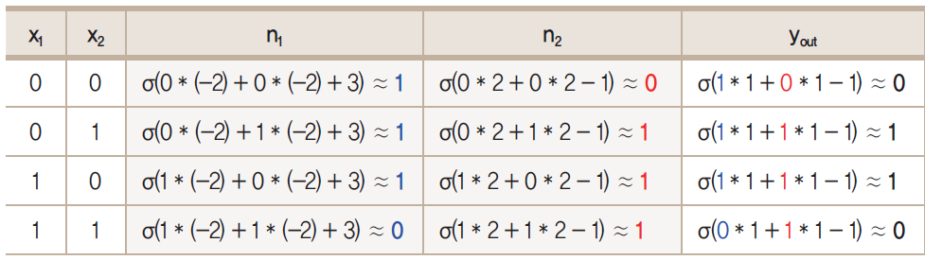
Basic Concepts for Neural Networks
Solving the XOR problem using multilayer perceptron
y_{true}
0
1
1
0

Slide 27
Basic Concepts for Neural Networks
Solving the XOR problem using multilayer perceptron
y_{true}
0
1
1
0
NAND(Negative And)
AND
NAND
x1 | x2 | return
0 | 0 | 0
0 | 1 | 0
1 | 0 | 0
1 | 1 | 1
x1 | x2 | return
0 | 0 | 1
0 | 1 | 1
1 | 0 | 1
1 | 1 | 0
1 is returned, when both x1 and x2 are 1
The opposite value of AND gate

Slide 28
Basic Concepts for Neural Networks
Solving the XOR problem using multilayer perceptron based on python manual code
https://colab.research.google.com/github/JunetaeKim/DeepLearningClass/blob/main/Week6/Week6_XOR_MLP.ipynb

Slide 29
Basic Concepts for Neural Networks
Introduction to Backpropagation

Slide 30
Basic Concepts for Neural Networks
Backpropagation
A method for training the weight matrices of a neural network
Backpropagation is an extended concept of gradient descent.
Basic principle
Calculates the error between the predicted value and the actual value based on weight matrices, and updates the weight matrices iteratively so that the error is minimized.
The backpropagation algorithm is the process of estimating the weights (values where the slope becomes 0 when differentiating) that minimize the predicted error.

Slide 31
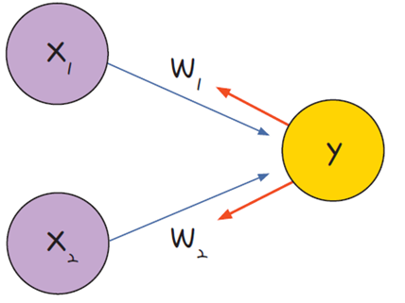
Basic Concepts for Neural Networks
Backpropagation
Calculate the error and adjust the weights learned in the previous epoch based on the error
Adjusting the weights
Calculating the error
In the case of perceptron

Slide 32
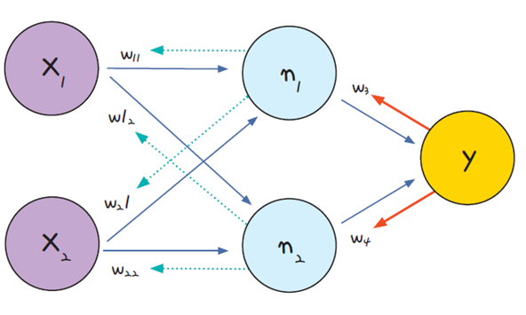
Basic Concepts for Neural Networks
Backpropagation
Calculate the error and adjust the weights learned in the previous epoch based on the error
② Adjusting the weights in the hidden layer
① Adjusting the weights in the output layer
Calculating the error
In the case of multilayer perceptron

Slide 33
Basic Concepts for Neural Networks
Working procedure of backpropagation
① Predict the outcome values(y_{out}) based on randomly initialized weight matrices(w)
② Calculates the error between the predicted result and the actual value
③ Using gradient descent algorithm, the weights learned in the previous epoch are updated so that the error is small.
④ Repeat the above process until the error no longer decreases.

Slide 34
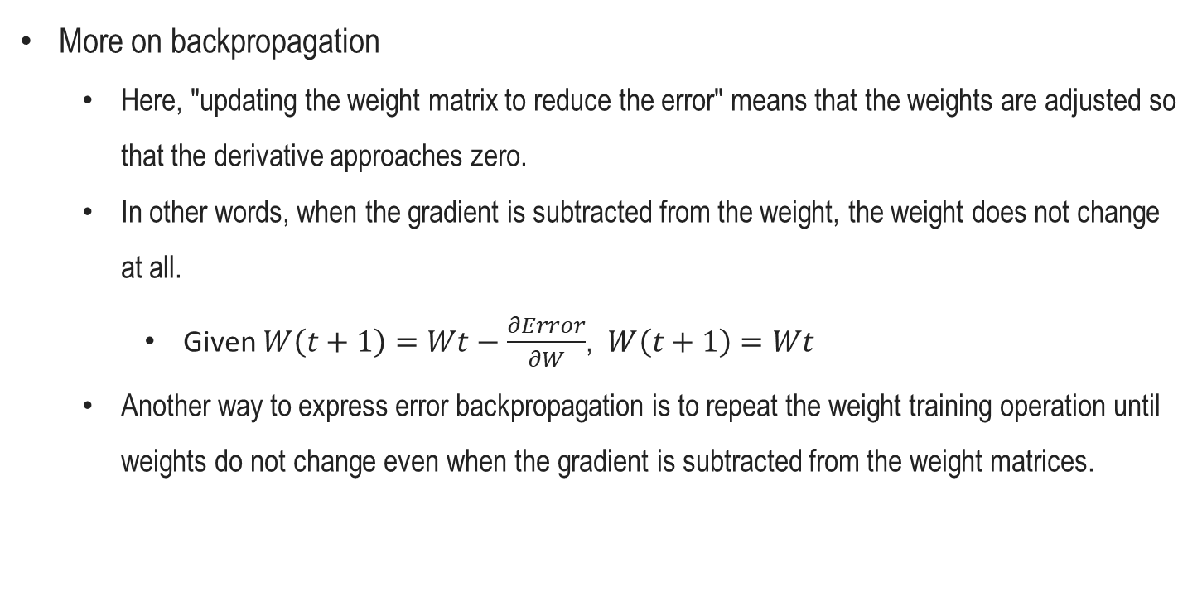
Basic Concepts for Neural Networks
More on backpropagation
Here, "updating the weight matrix to reduce the error" means that the weights are adjusted so that the derivative approaches zero.
In other words, when the gradient is subtracted from the weight, the weight does not change at all.
Given $W\left(t+1\right)=Wt−\frac{∂Error}{∂W}$, $W\left(t+1\right)=Wt$
Another way to express error backpropagation is to repeat the weight training operation until weights do not change even when the gradient is subtracted from the weight matrices.

Slide 35
Basic Concepts for Neural Networks
Gradient Vanishing Problem

Slide 36
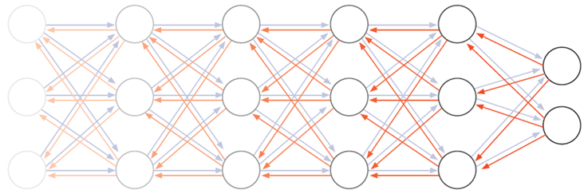
Basic Concepts for Neural Networks
Backpropagation algorithm summary
Adjusting the weights of each layer by moving backward from the output layer.
To train the weights, the derivative value, i.e. the slope, is required.

Slide 37
Basic Concepts for Neural Networks
Gradient vanishing problem
When there are multi-layers, the gradient of the layers close to the input is very small, so the parameters of those layers are not updated.
As shown in the figure below, the closer to the input, the more blurred the edges and nodes, which indicates that the value of the gradient gradually decreases.

Slide 38
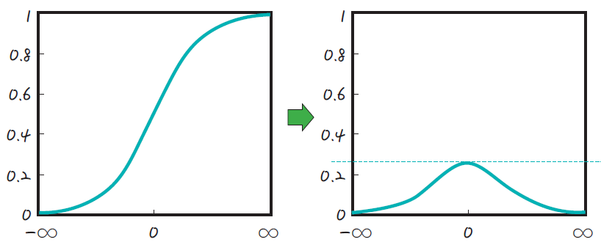
Basic Concepts for Neural Networks
Causes of gradient vanishing problem
The gradient vanishing problem is due to the nature of the sigmoid function used as the activation function.
As the parameter is trained through multiple layers, the gradient disappears, making it difficult to train the weights.
Sigmoid
Derivatives of sigmoid
Max <= 0.3

Slide 39
Basic Concepts for Neural Networks
Understanding of gradient vanishing problem
https://colab.research.google.com/github/JunetaeKim/DeepLearningClass/blob/main/Week6/Week6_GradVanish.ipynb

Slide 40
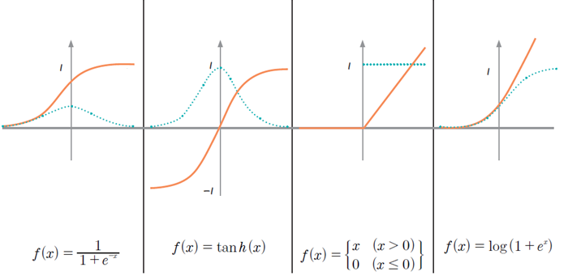
Basic Concepts for Neural Networks
Efforts to minimize the problem
To solve this problem, several functions that can be used instead of a sigmoid as the activation function have been introduced.
sigmoid
tanh
relu
softplus
function
derivative

Slide 41
Basic Concepts for Neural Networks
Activation functions
Hyperbolic tangent function:
It has the effect that the range of the derivative value is expanded than that of the sigmoid.
It has still gradient vanishing problem because derivatives less than 1 still exist
Rectified Linear Unit(ReLu):
It is currently the most used activation function as an alternative to the sigmoid function.
Even if the derivatives are multiplied through multiple hidden layers, the values ​​may remain.
This simple method made it possible to stack multiple layers, thereby accelerating advances in deep learning.

Slide 42
Basic Concepts for Neural Networks
Activation functions
Softplus function:
Differentiating ReLu results in zero values, so the weight matrix of zero nodes is no longer trained.
Therefore, it is a function that improves the advantages of ReLU so that the derivatives do not become zero.

Slide 43
Basic Concepts for Neural Networks
Advanced Gradient Descent

Slide 44
Basic Concepts for Neural Networks
Limitation of gradient descent method
Gradient descent estimates the weights accurately, but has a disadvantage in that the amount of computation is very high because the entire data has to be differentiated for each update.
The optimization process may stop before finding the optimal solution.

Slide 45
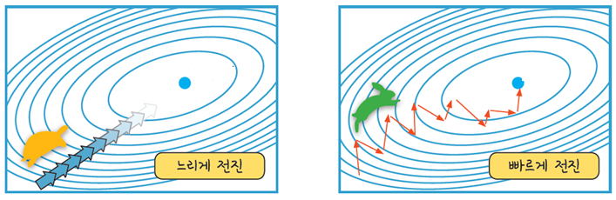
Basic Concepts for Neural Networks
The advent of stochastic gradient descent (SGD)
Instead of using the entire data, some randomly selected data is used for training.
By using some data, it is possible to update faster and more often
Since SGD uses random data, it may appear unstable with large amplitudes of errors in progress.
slow convergence
fast convergence
GD
SGD

Slide 46
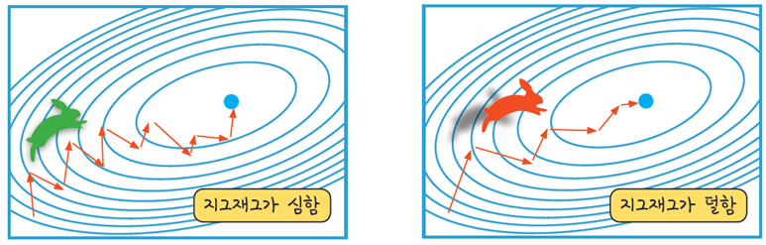
Basic Concepts for Neural Networks
Introduction to momentum
The word “momentum” means “inertia, elasticity, acceleration”.
Momentum SGD literally means adding momentum to gradient descent.
By introducing momentum into SGD, parameters are updated only at a certain rate in the same direction by referring to the previous updated value and direction (+, -) before updating the parameter.
As a result, the unstable fluctuations of large errors can be reduced.
High fluctuation
Low fluctuation
SGD
SGD with momentum

Slide 47
Basic Concepts for Neural Networks
Representative optimizers for deep learning training
Dozens of optimizers exist, and new optimizers are still being researched and developed.

Slide 48
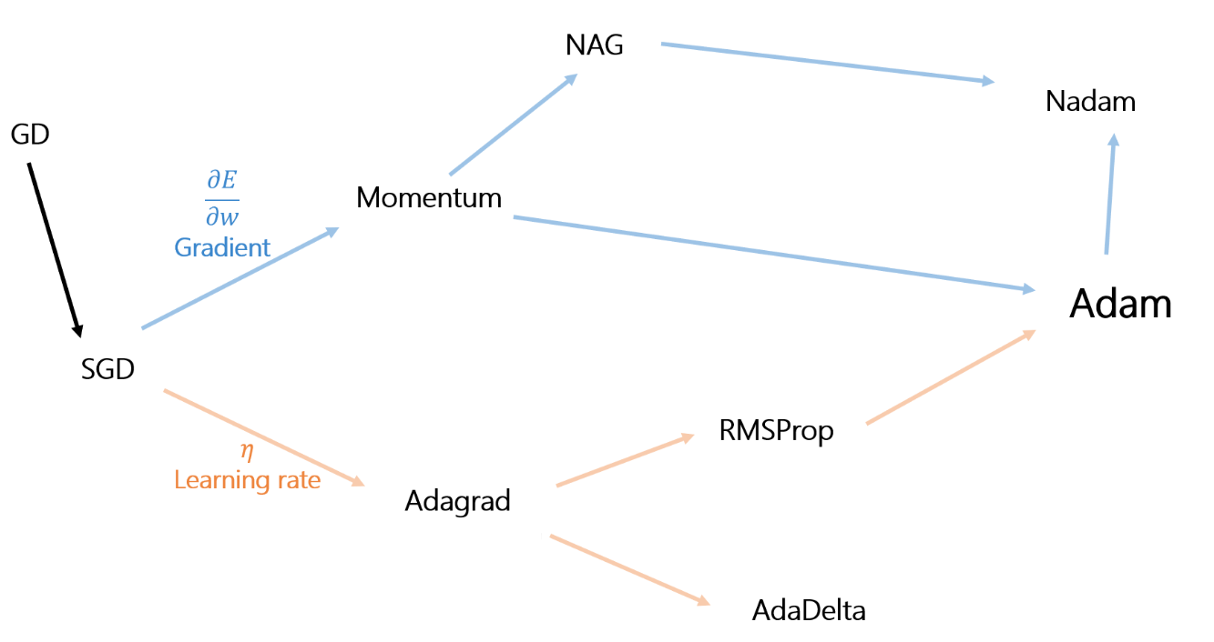
Basic Concepts for Neural Networks
Representative optimizers for deep learning training
Applying NAG instead of momentum in Adam
All data is fully utilized
Calculate the slope by moving in advance in the direction the momentum will move
Minimize fluctuations by introducing momentum
learn with both gradient and learning rate taken into account
Update frequently with small bits of random data
Learn in detail, but have some flexibility
Learn fast at first, learn more detail later
Prevent learning from being too detailed

